Slide 1
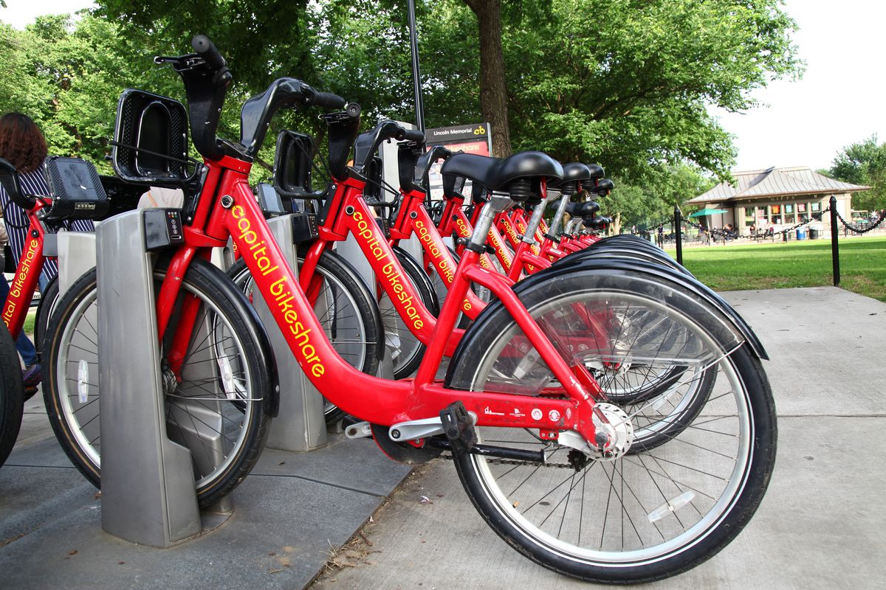
Understanding the demand on bike sharing
Weihong & Xiaowen

Slide 2
Contents
Introduction
Data acquisition & data cleaning
Data description
Data visualization between independent & dependent variables
Data splitting
Model fitting with CV prediction & Model performance
Model selection

Slide 3
Introduction
Problem description:
Capital bikeshare is a company that provides bicycle sharing services, it serves Washington, D.C. and neighbors.
Our objective for this project is to make prediction about the daily demand on bike sharing based on the environmental and seasonal settings.
These factors include season, temperature (Celcius), workingday, holiday, and weather condition.

Slide 4
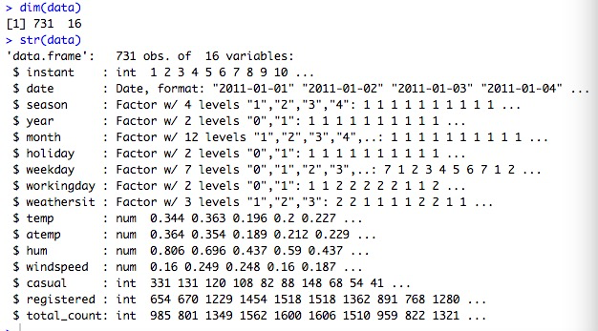
Data acquisition & data cleaning
Dataset from http://archive.ics.uci.edu/ml/datasets/Bike+Sharing+Dataset/

Slide 5
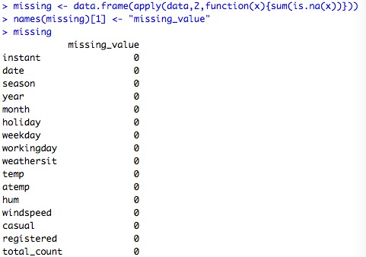

Slide 6
Data description
season : season (1:springer, 2:summer, 3:fall, 4:winter)
yr : year (0: 2011, 1:2012)
mnth : month ( 1 to 12)
holiday : weather day is holiday or not (extracted from http://dchr.dc.gov/page/holiday-schedule)
weekday : day of the week
workingday : if day is neither weekend nor holiday is 1, otherwise is 0.
weathersit :
- 1: Clear, Few clouds, Partly cloudy, Partly cloudy
- 2: Mist + Cloudy, Mist + Broken clouds, Mist + Few clouds, Mist
- 3: Light Snow, Light Rain + Thunderstorm + Scattered clouds, Light Rain + Scattered clouds
- 4: Heavy Rain + Ice Pallets + Thunderstorm + Mist, Snow + Fog
temp : Normalized temperature in Celsius. The values are divided to 41 (max)
hum: Normalized humidity. The values are divided to 100 (max)
windspeed: Normalized wind speed. The values are divided to 67 (max)
cnt: count of total rental bikes including both casual and registered

Slide 7
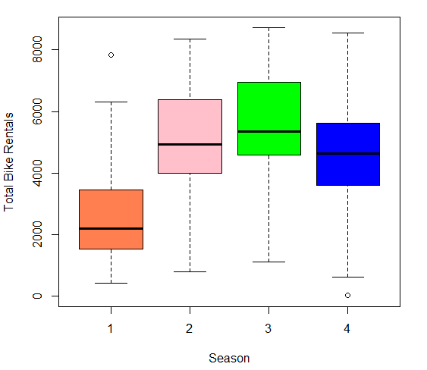
Visualization：Season vs Counts

Slide 8
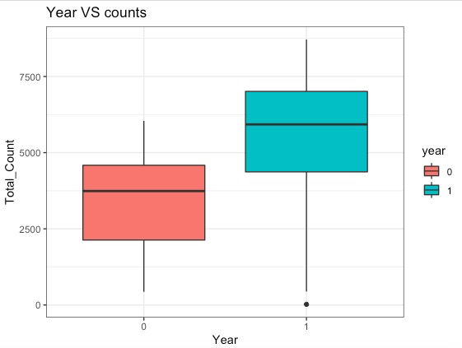
Year vs Counts

Slide 9
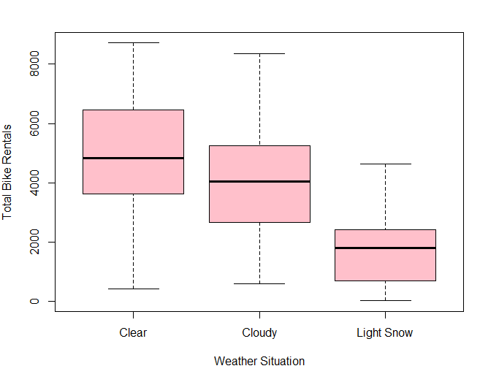
Weather situation vs Counts

Slide 10
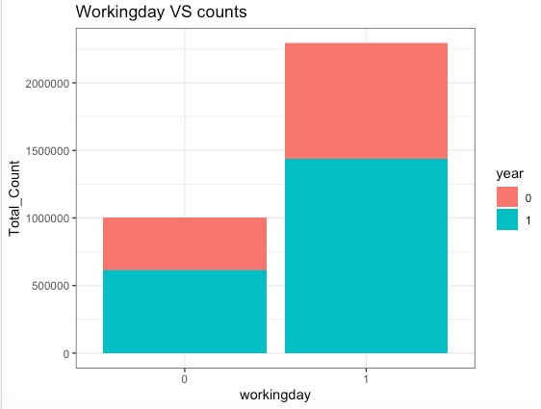
Working day vs Counts

Slide 11
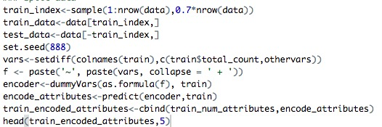
Split the dataset into training data (70%) and testing data (30%)
Transfer categorical variables to dummy variables

Slide 12
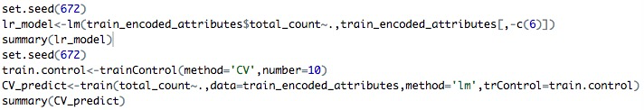
Linear model with 10-fold CV prediction

Slide 13
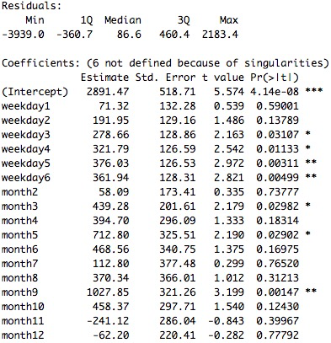
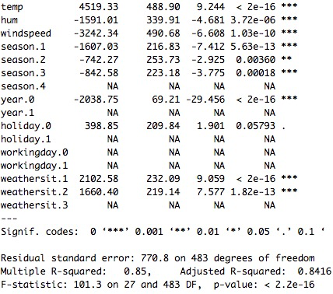

Slide 14
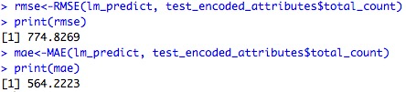
Test performance

Slide 15
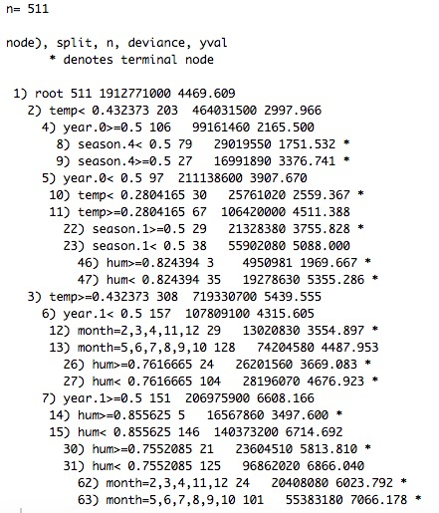
Decision tree regression model

Slide 16
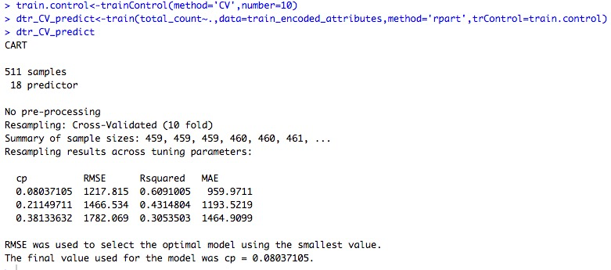
Decision tree regression model with 10 fold CV prediction

Slide 17
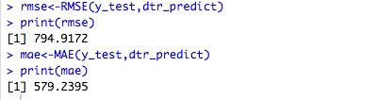
Test performance

Slide 18
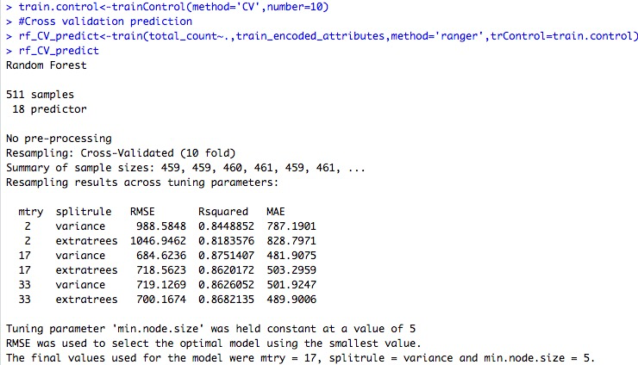
Random forest model with 10-fold CV prediction

Slide 19
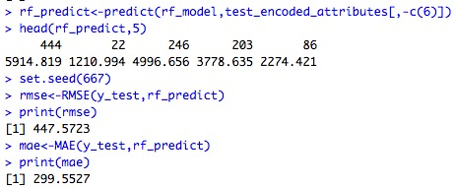
Test performance

Slide 20
Model Selection
When we compare the root mean squared error (RMSE) and mean absolute error (MAE) of all 3 models, the random forest model has less root mean squared error and mean absolute error. So, finally random forest model is best for predicting the bike rental count on daily basis.

Slide 21


